Slide 1

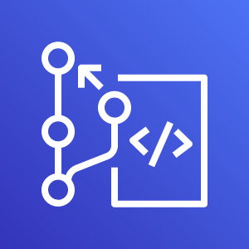

Triggers and notifications
Wolfgang Unger
AWS Solutions Architect | Instructor

Slide 2
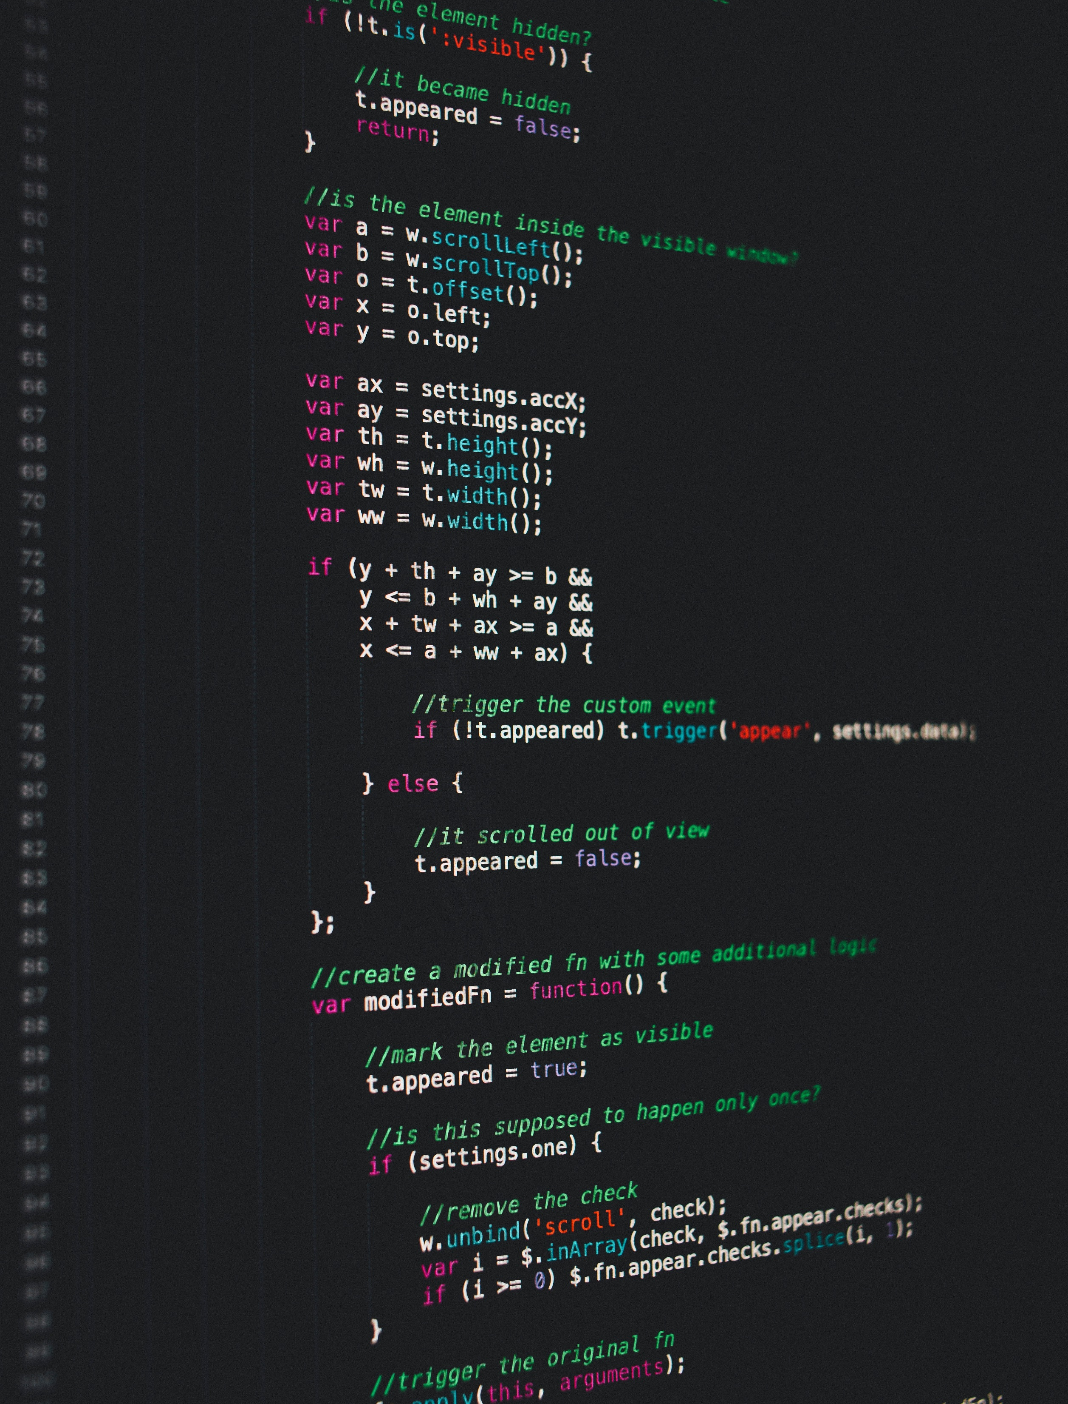

Trigger event types
All repository events
Push to existing branch
Create a branch or tag
Delete branch or tag

Slide 3

Notification with Amazon SNS
Create Topic for the CodeCommit triggers
Create subscription for topic
Select subscription protocol
Email
HTTP/HTTPS for webhooks

